Slide 1
Visualization of scoliotic spine using ultrasound-accessible skeletal landmarks
Ben Church¹, Andras Lasso¹, Christopher Schlenger², Daniel P. Borschneck³, Parvin Mousavi⁴, Gabor Fichtinger^{1,3}, Tamas Ungi^{1,3}
Laboratory for Percutaneous Surgery, School of Computing, Queen’s University, Kingston, ON, Canada
Premier Chiropractic, Stockton, CA, USA
Department of Surgery, Queen’s University, Kingston, ON, Canada
Medical Informatics Laboratory, School of Computing, Queen’s University, Kingston, ON, Canada

Slide 2
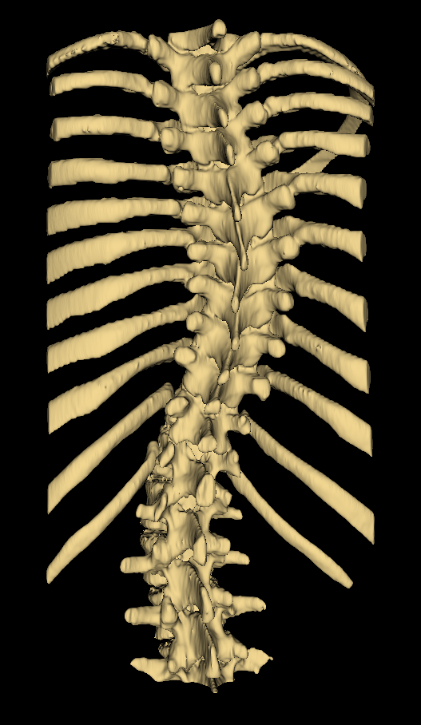
Introduction - Scoliosis
Scoliosis is lateral spinal curvature
Curvature often progresses until skeletal maturity
Regular assessment helps ensure early treatment

Slide 3
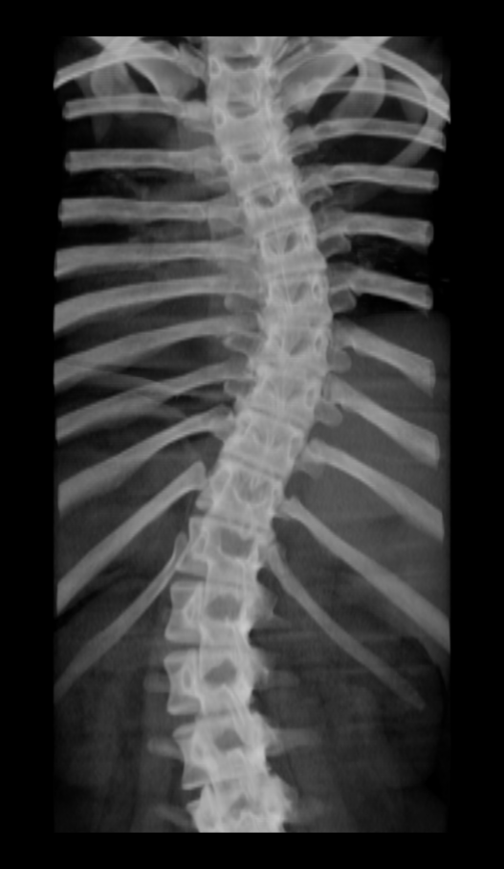
Introduction - Assessment
Gold-standard assessment method is X-ray imaging
Cobb angle is measured
Quantifies severity of scoliosis

Slide 4
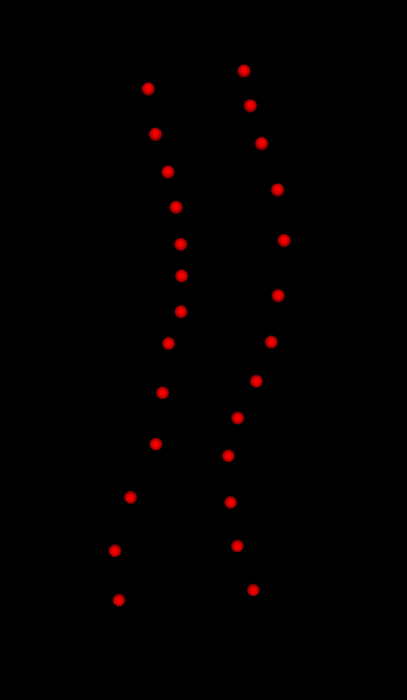
Introduction – Tracked Ultrasound
Motivated by X-ray health risks
Methods typically locate skeletal landmarks
Curvature extracted from landmarks

Slide 5
Problem Description
Current ultrasound methods do not produce easily interpreted visualizations

Slide 6
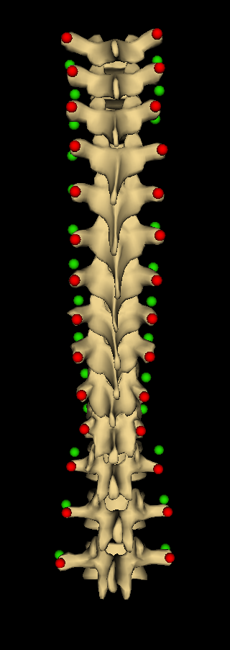
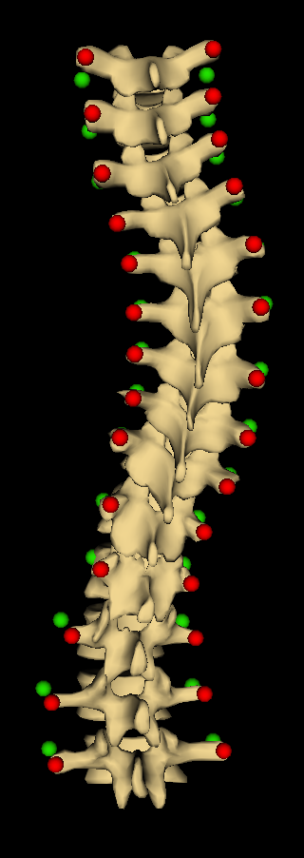
Contribution
A method for producing informative spinal visualizations
Average shaped spine is warped to patient anatomy using registration points

Slide 7
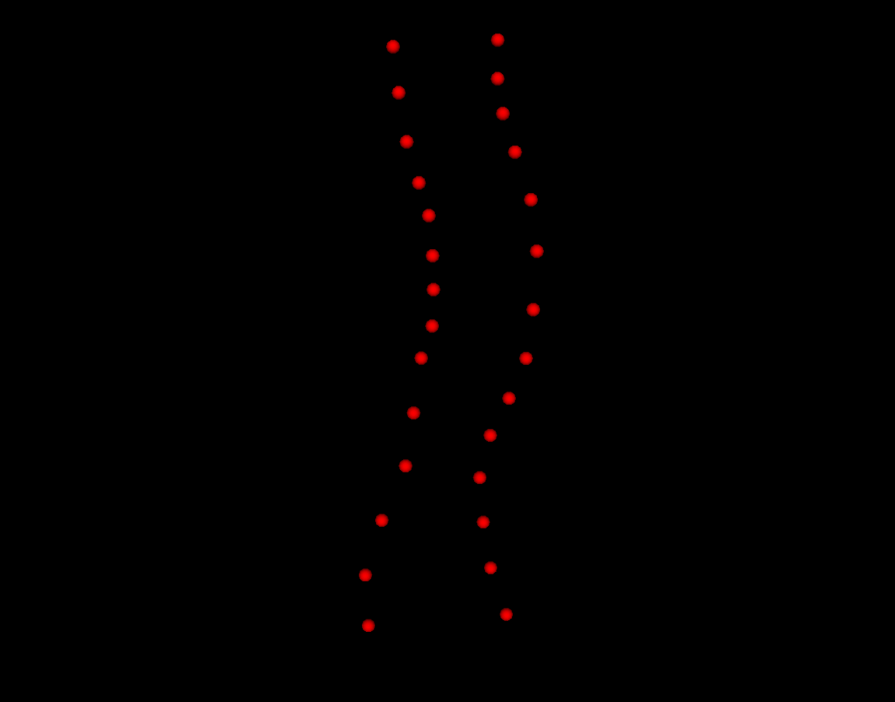
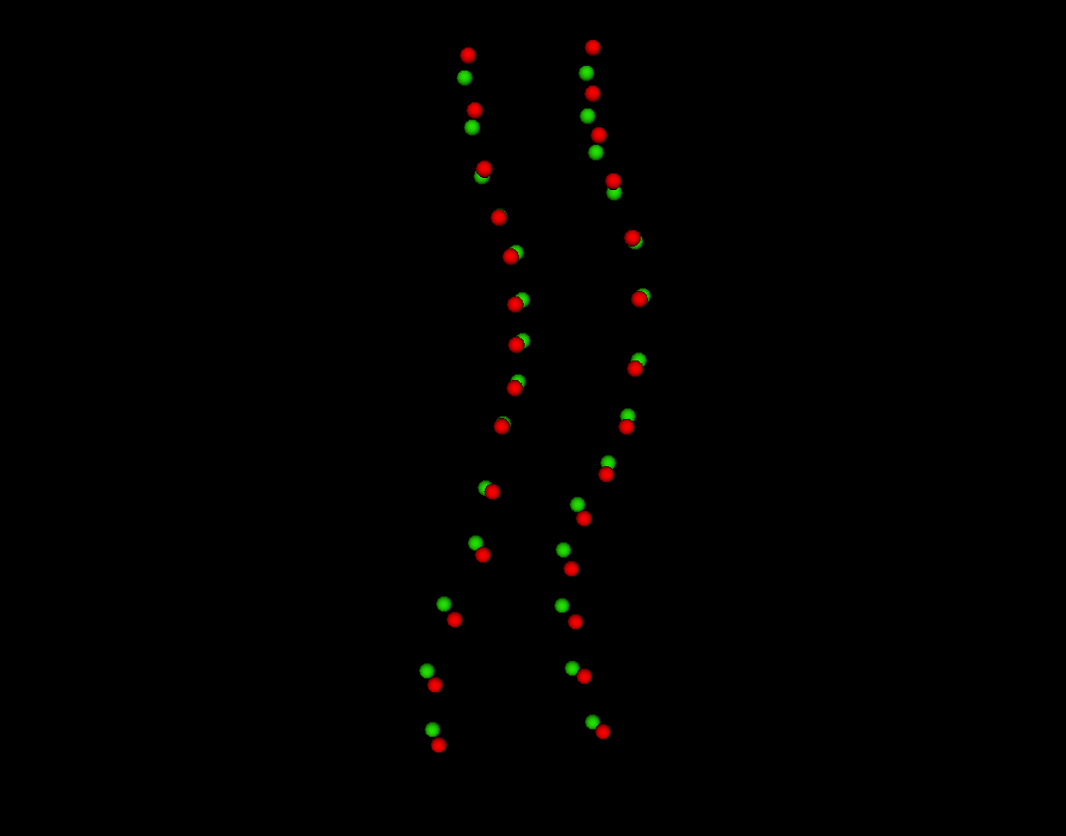
Contribution
We supplemented transverse process locations with anchor points to ensure registration is anatomically realistic

Slide 8
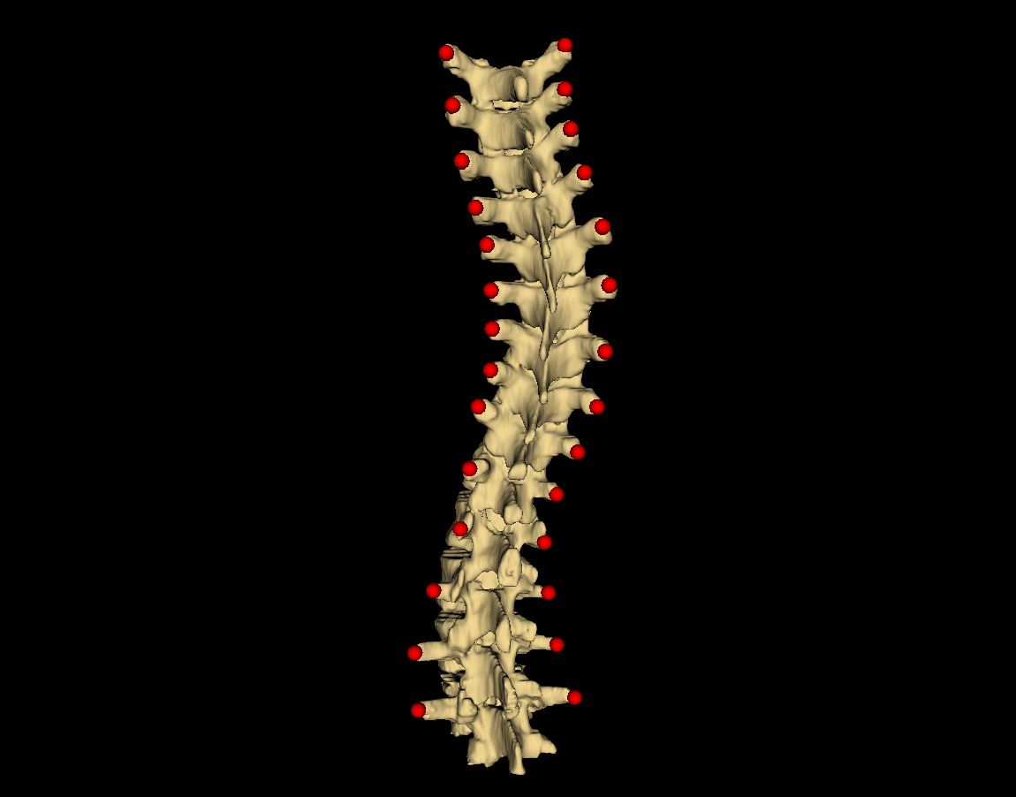
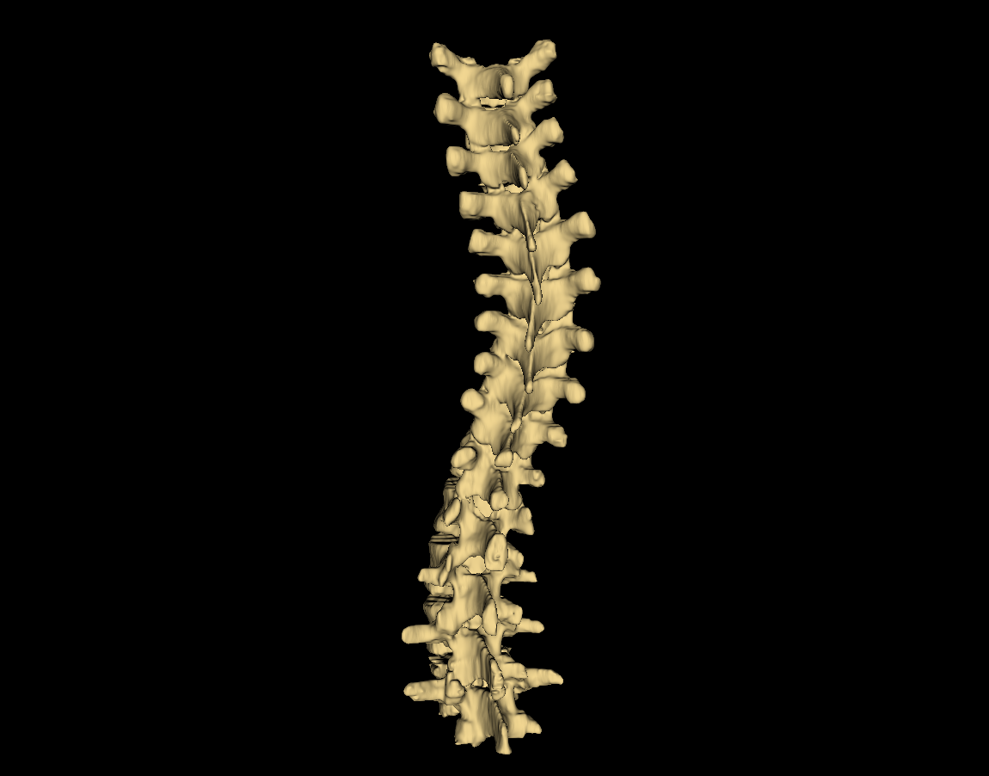
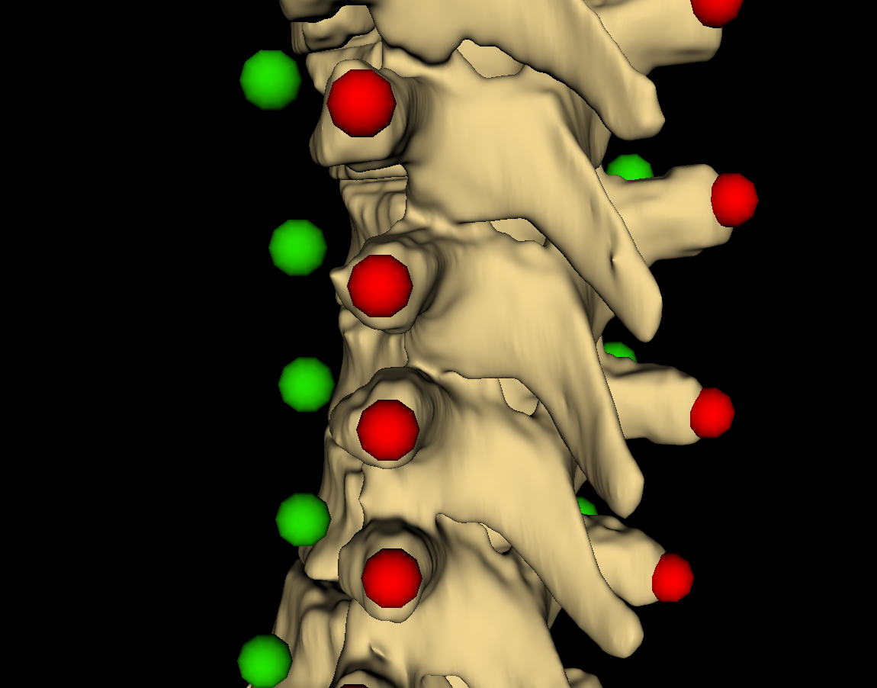
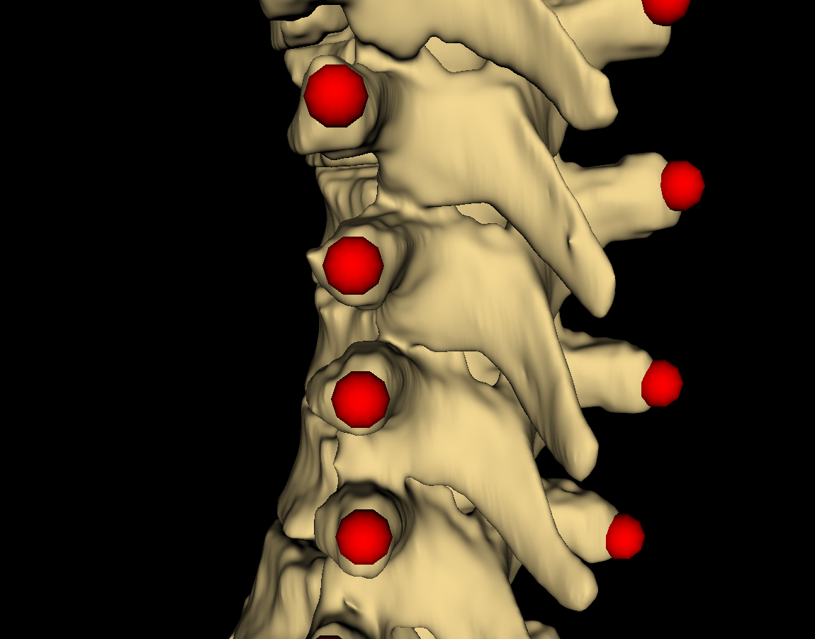
Methods
Transverse processes located using patients’ prior CT scans
Anchor point locations calculated from landmark locations

Slide 9
Methods
Anchor points offset towards anterior anatomy of vertebrae from landmarks
This conveys anterior-posterior scale and vertebral rotation

Slide 10
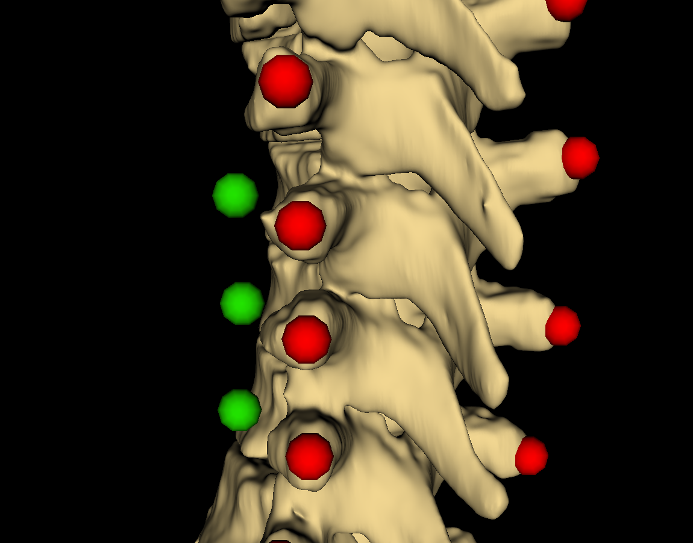
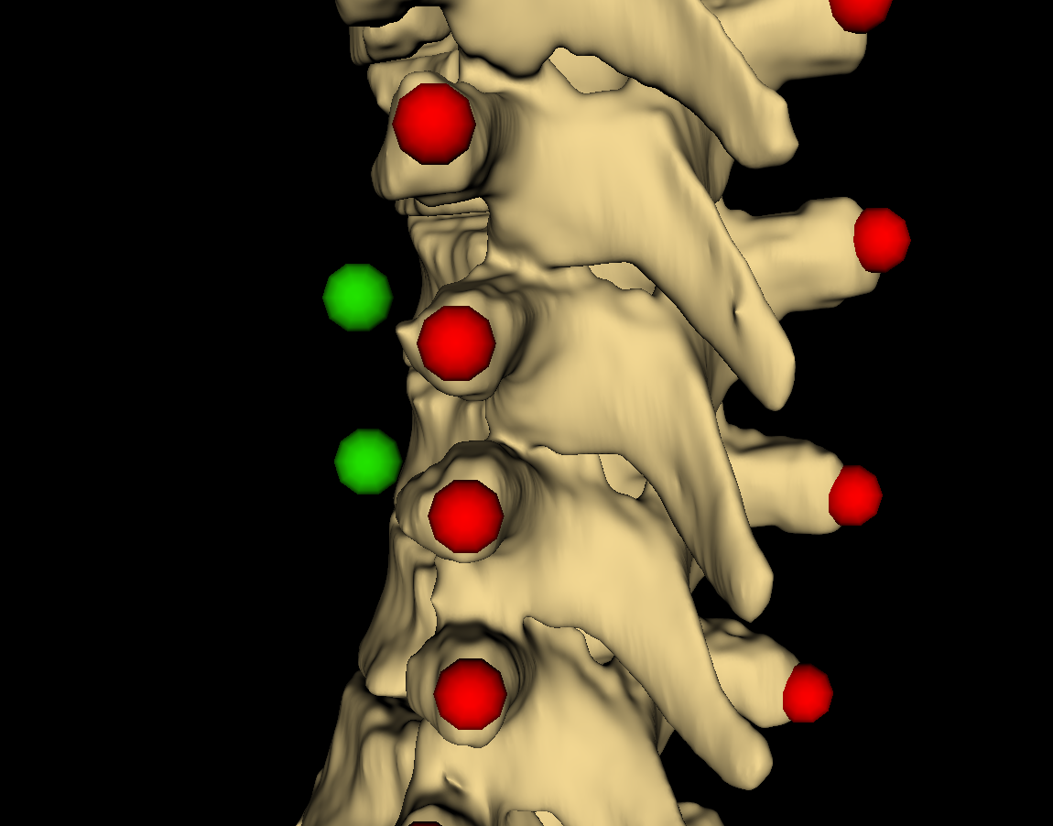
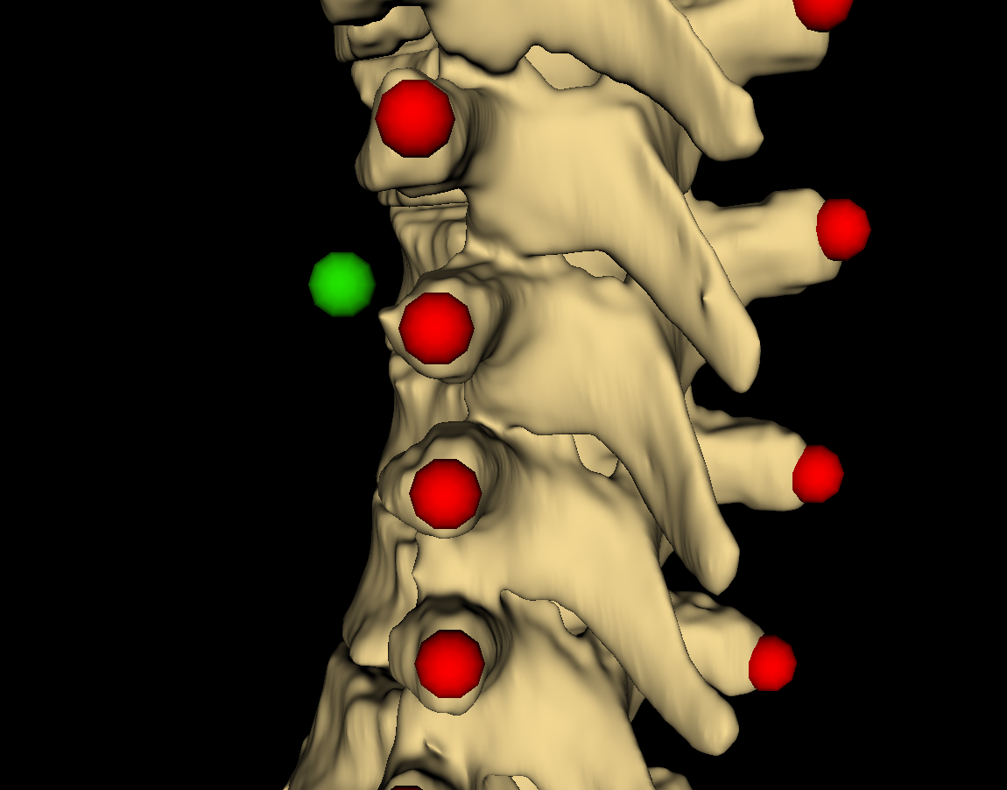
Methods
Directions of offsets determined from local inter-landmark geometry
Cross product of axial and lateral vectors point in desired direction

Slide 11
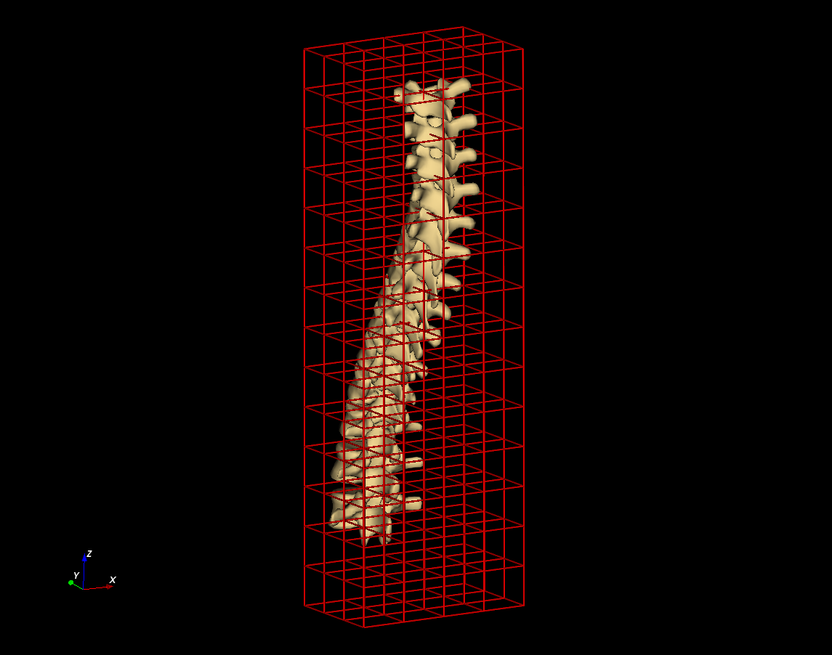
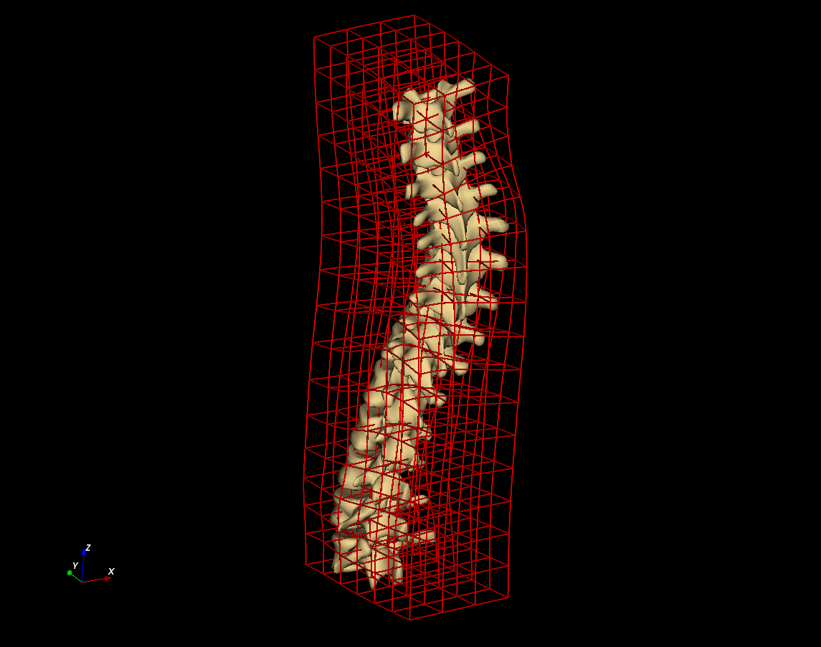
Methods
Landmark registration then computed the thin-plate spline deformation field which warps model points to the patients’
Deformation field was applied over average model, warping it to patient anatomy

Slide 12
Methods
Results visualizations were assessed compared to ground truth CT scans
Model to patient distance maps and Hausdorff distances were computed

Slide 13
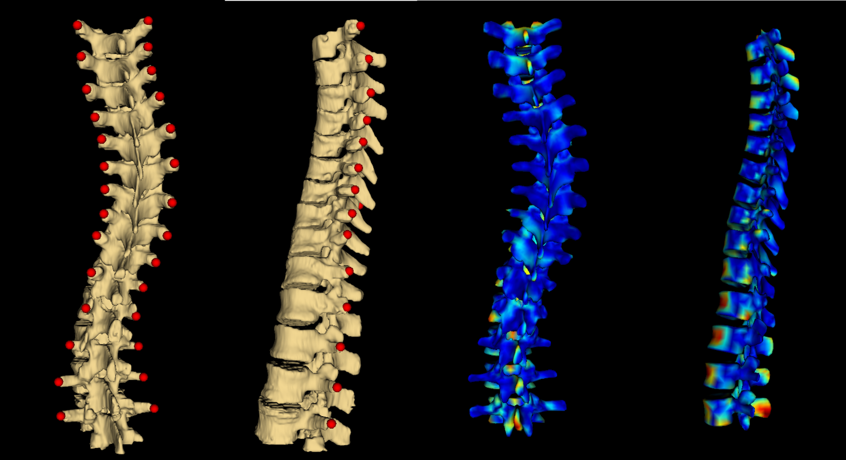
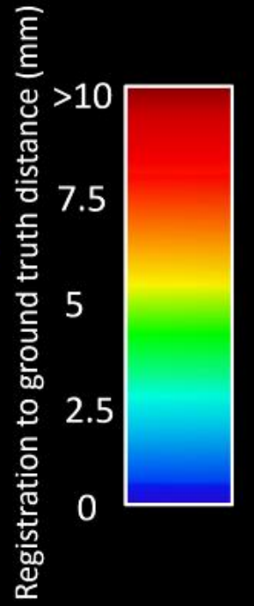
Results
Average Hausdorff distance: 2.8mm
Maximum Hausdorff distance: 20.0mm

Slide 14
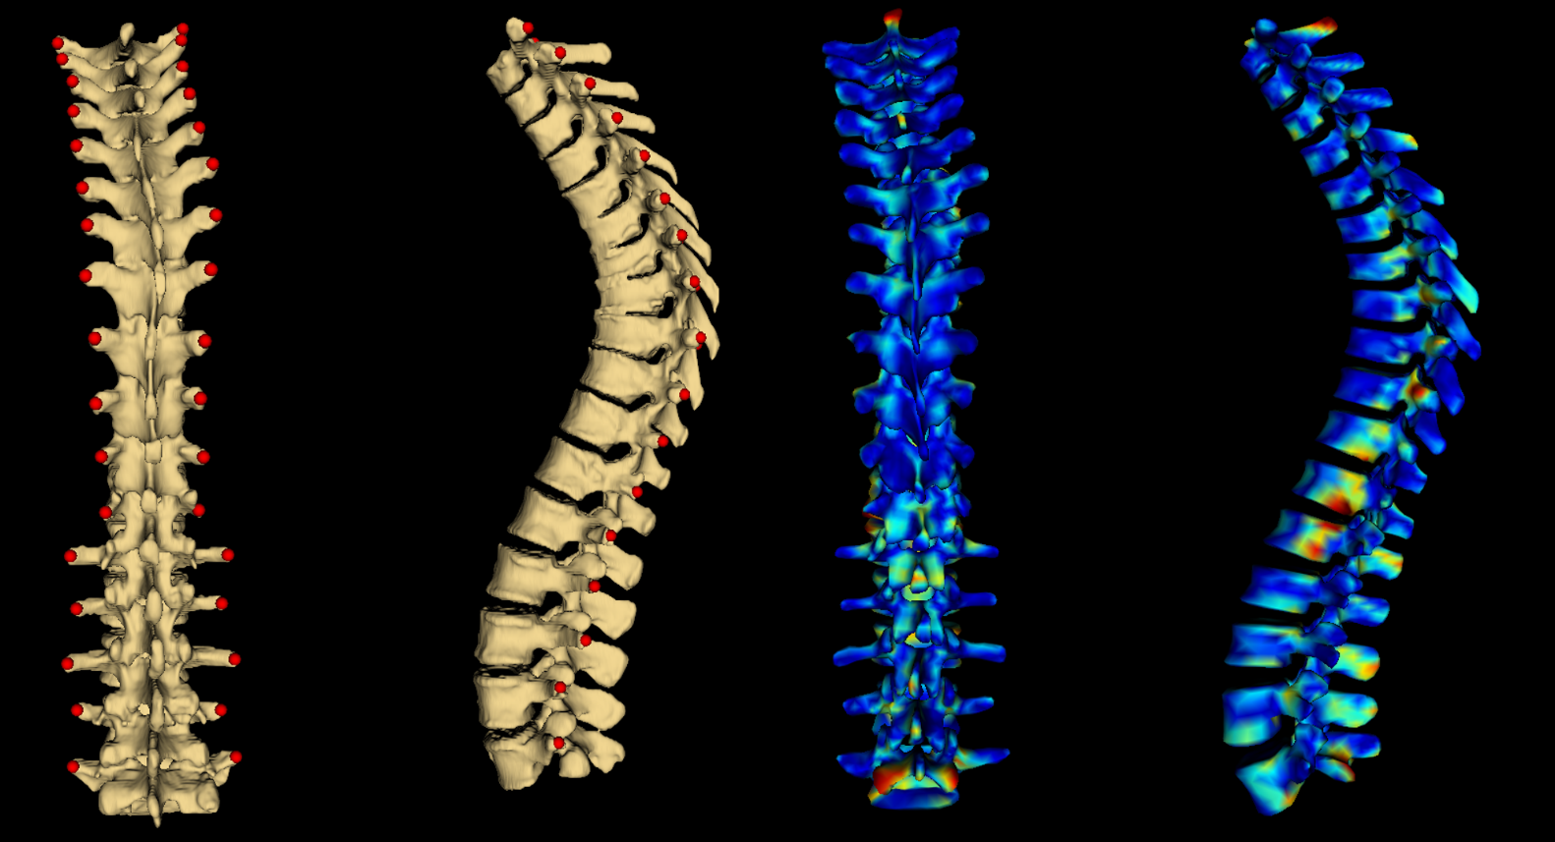
Results
Average Hausdorff distance: 2.3mm
Maximum Hausdorff distance: 24.0mm

Slide 15
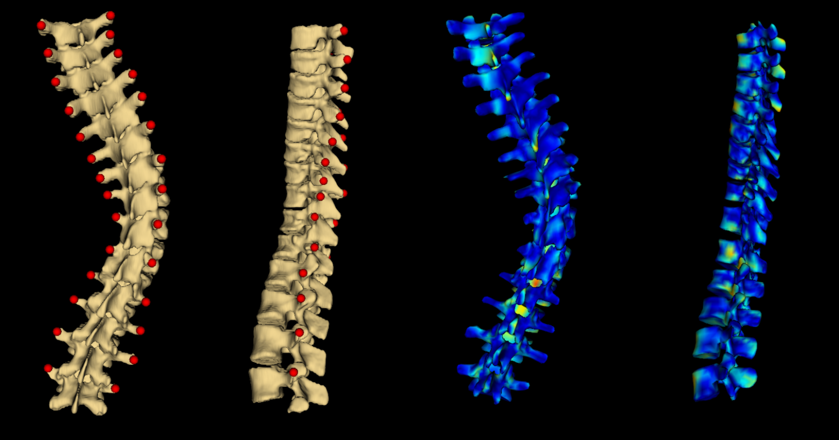
Results
Average Hausdorff distance: 2.4mm
Maximum Hausdorff distance: 17.7mm

Slide 16
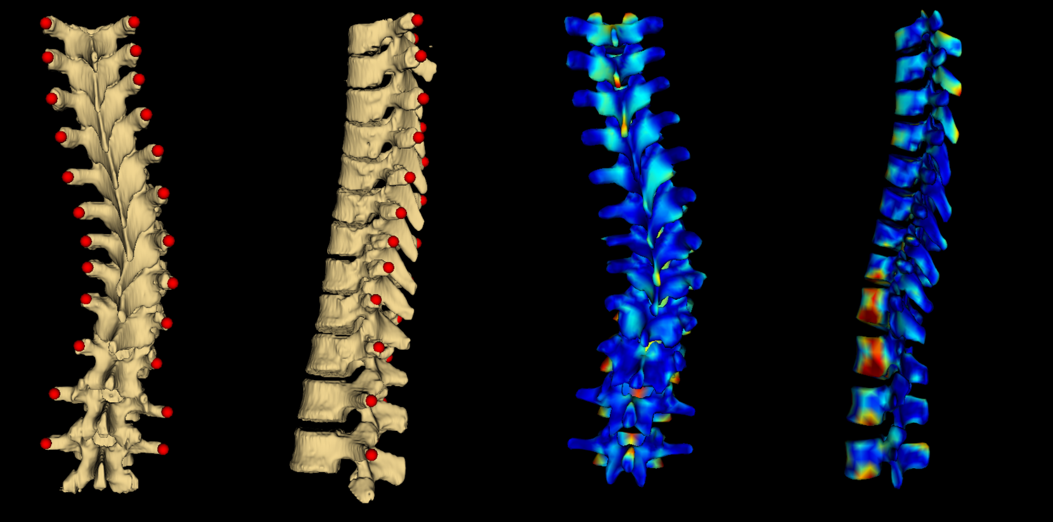
Results
Average Hausdorff distance: 2.9mm
Maximum Hausdorff distance: 18.1mm

Slide 17
Discussion
Visualizations convey overall form of patients’ spines
Misalignment mainly at superior and inferior ends, and in anterior anatomy

Slide 18
Conclusions
Proposed method produces informative visualizations
Does not serve to replace quantitative measures, but to supplement them

Slide 19
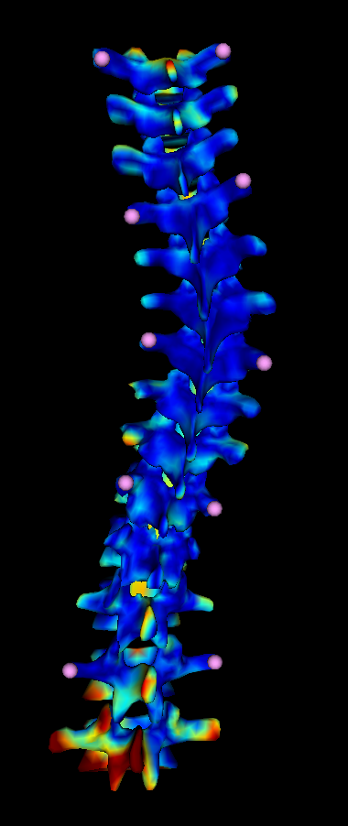
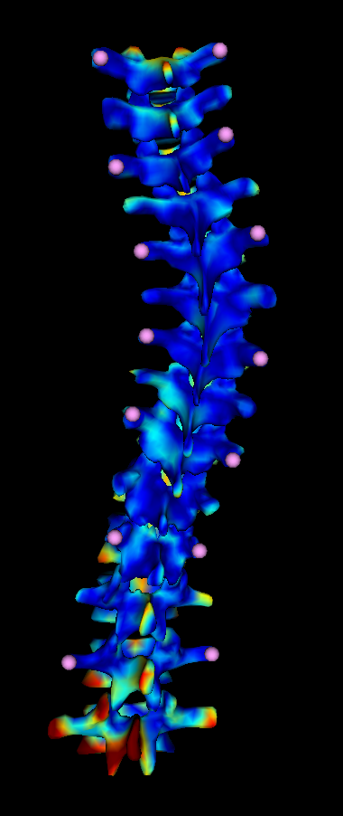
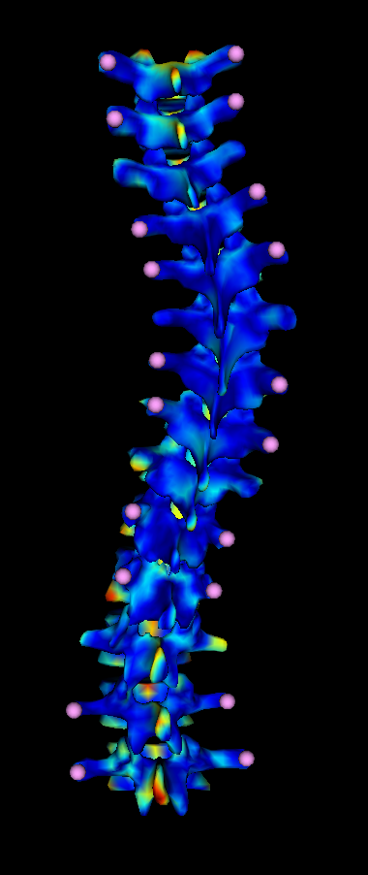
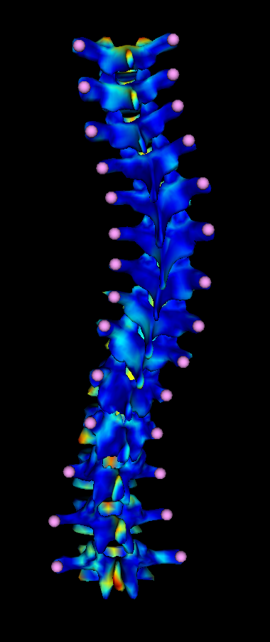
Ongoing Work
Investigating robustness with respect to missing, misplaced, or mislabeled landmarks
1/3
1/2
2/3
1/1

Slide 20
Thank you! Questions?

